Slide 1
CENTRE FOR DEVELOPMENT OF ADVANCED COMPUTING, NOIDA
Name | PRN Number
Amol Chemate | 220920520035
Vaibhav Ghatol | 220920520048
Balasaheb Pawar | 220920520027
Hrushikesh Galande | 220920520043
A PRESENTATION ON
“e-rail Ticket”

Slide 2
INTRODUCTION
The E-Rail Ticket facilitates the passengers to enquire about the trains available on the basis of source and destination, Booking and Cancellation of tickets, enquire about the status of the booked tickets, etc.
The aim of case study is to design and develop a database maintaining the records of different trains, train status, and passengers.
The record of train includes its number, name, source, destination, and days on which it is available, whereas record of train status includes dates for which tickets can be booked, total number of seats available and number of seats already booked.

Slide 3
OBJECTIVE
Our project introduces online railway reservation system with an objective to make the reservation system more efficient, easier and fast. This project explores how computer technology can be used to solve the problem of user. The main objectives provided by this software are as follows:
1.To enquire about availability of trains
2.To reserve and cancel their seats
3.To modify the information
This project is dedicated to model existing railway reservation systems that aim at development of Online Railway Reservation System that facilitates the railway customer to manage their reservations and the railway administrator to modify the backend database in a user-friendly manner.

Slide 4
MODULES
Admin Module
Customer Module

Slide 5
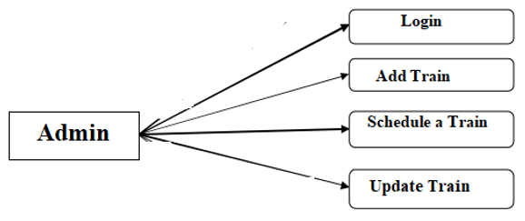
REQUIREMENTS
Admin Scope:-
Apart from functionalities like login, edit profile, change password, the admin can
Add a train route , schedule a train, update a train.

Slide 6
Flowchart of Admin
Start
Login
Schedule a Train
Add Train
Update Train
Logout

Slide 7
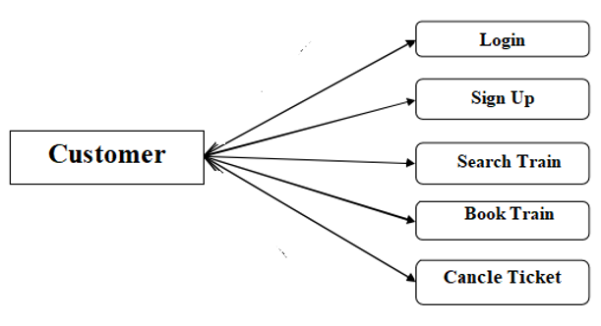
REQUIREMENTS
Customer Scope:-
Through this system customers can get the details about trains, their timing, their types related to the same on site in just a click.
The customer can view train schedules, the booking done by them, cancel booking.

Slide 8
Flowchart of User
Start
Sign Up
Login
Search train
Book Train Ticket
Cancel Ticket
logout

Slide 9
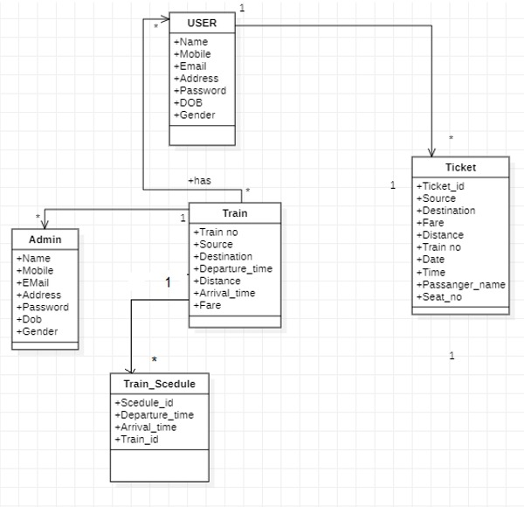
E-R Diagram

Slide 10
TABLES IN DATABASE
User Details
Train Details
Train schedule
Ticket Details

Slide 11
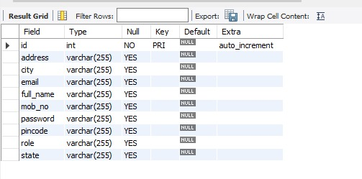
User-Details Table

Slide 12
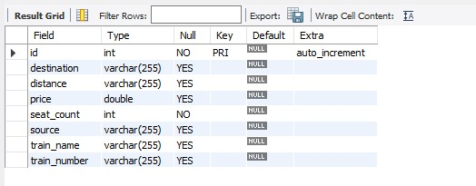
Train Details Table

Slide 13
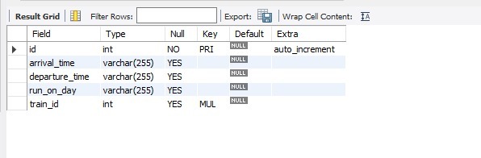
Train schedule Table

Slide 14
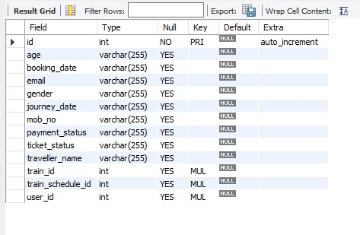
Ticket Details Table

Slide 15
TECHNICAL REQUIREMENTS
Frontend -React
DataBase -MySQL
Backend –Springboot & RestApi

Slide 16
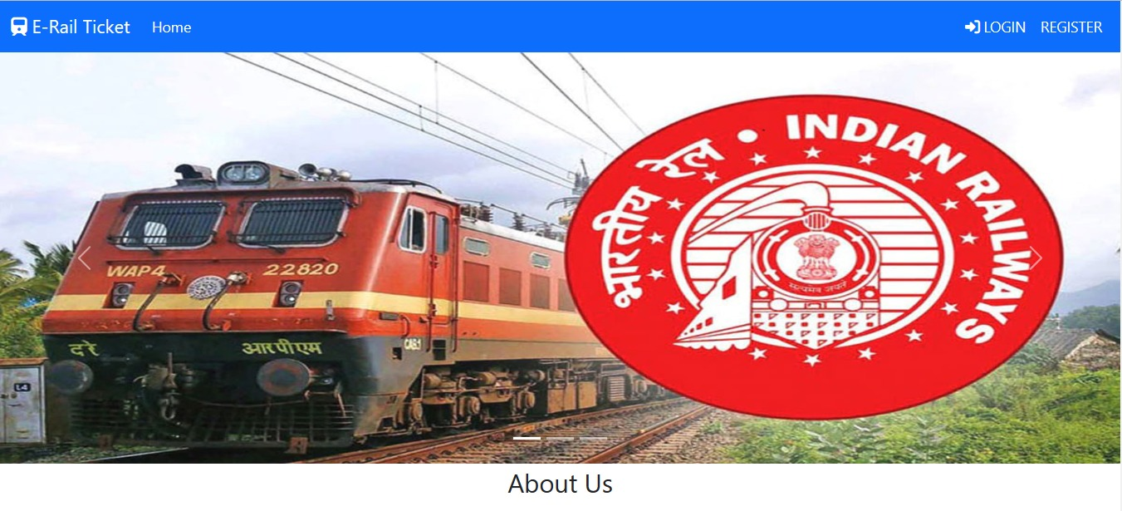
Home Page

Slide 17
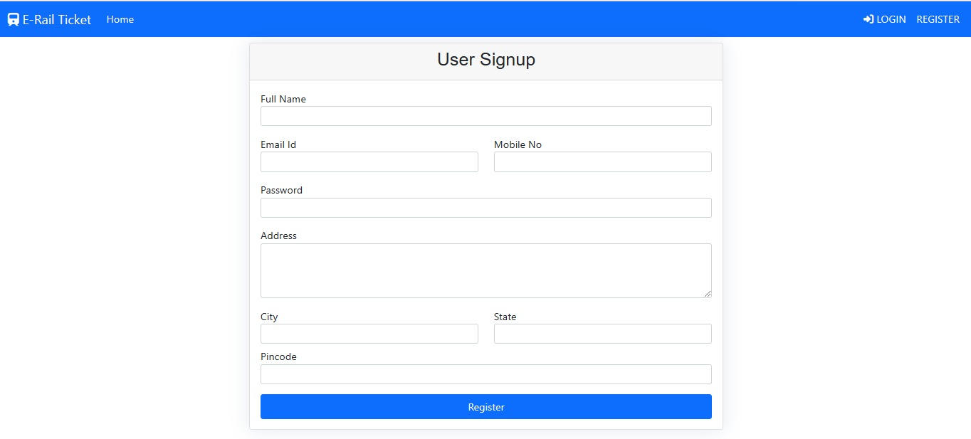
Signup Page

Slide 18
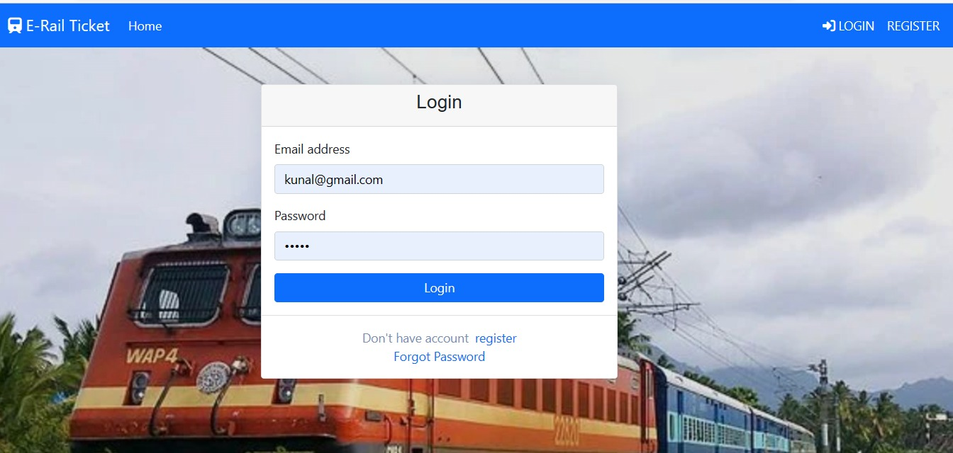
Login Page

Slide 19
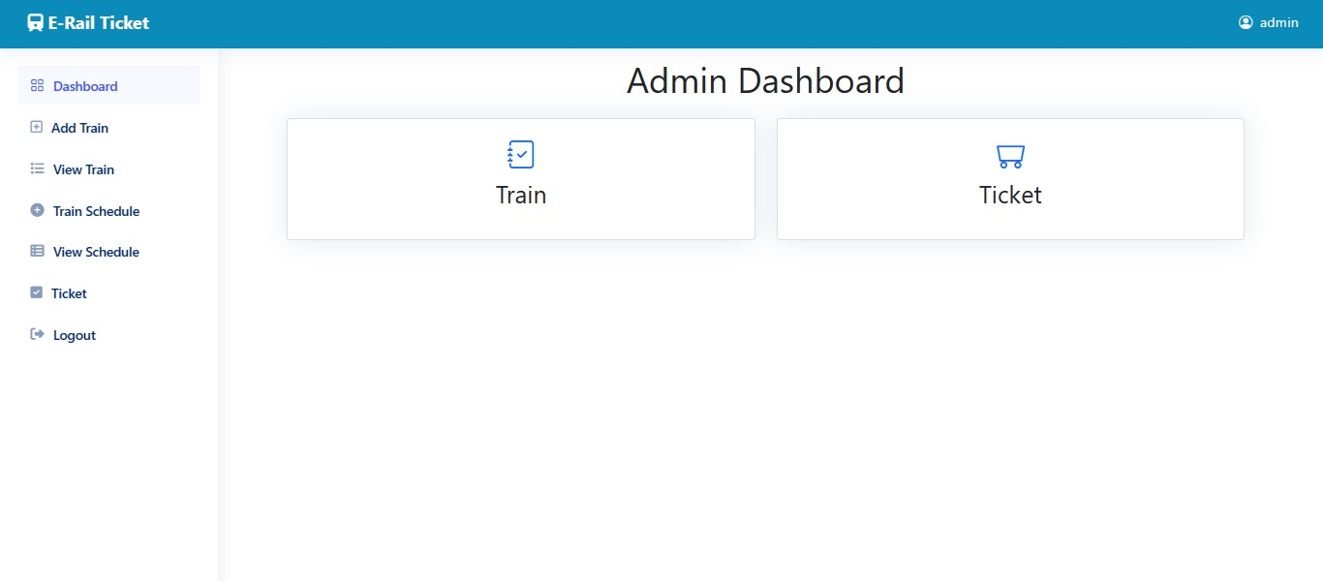
Admin Dashboard

Slide 20
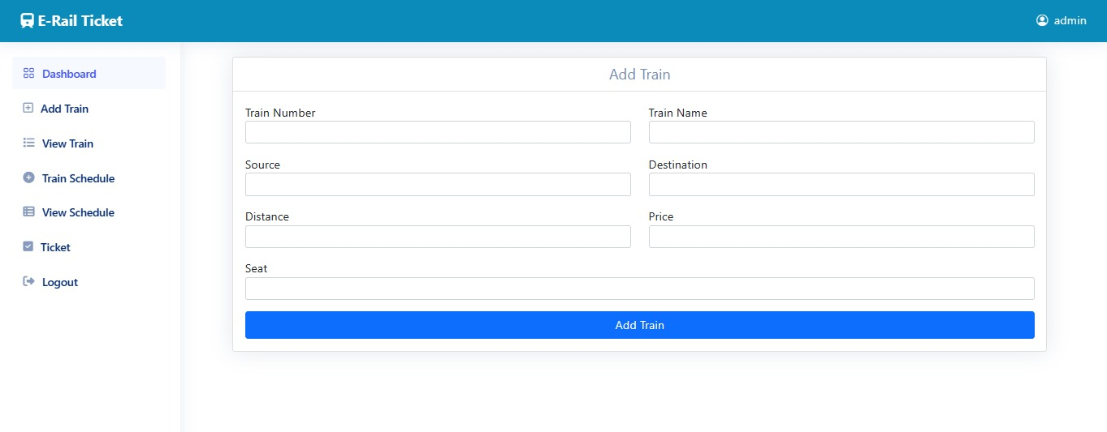
Add Train

Slide 21
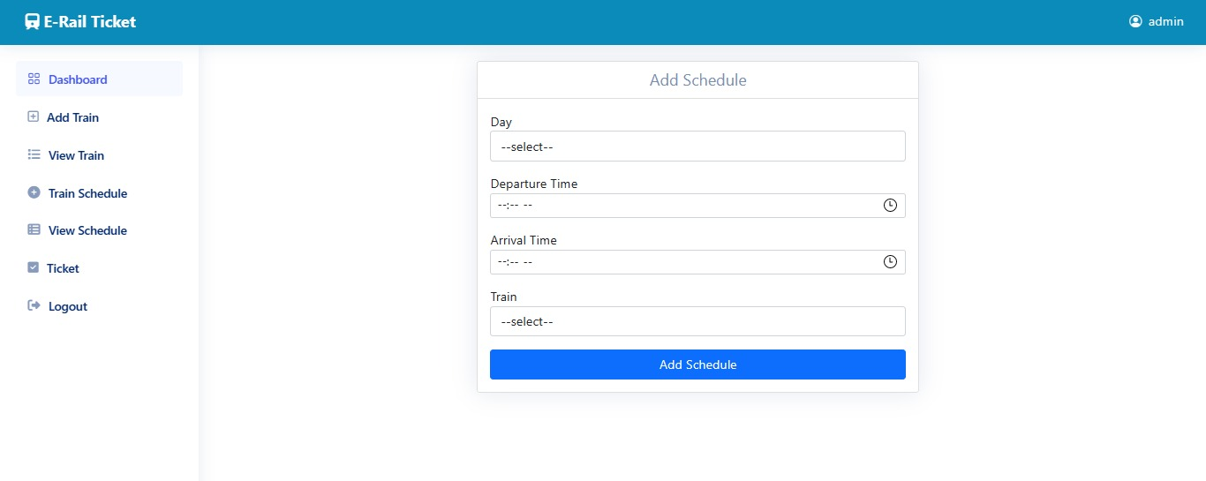
Add Schedule

Slide 22
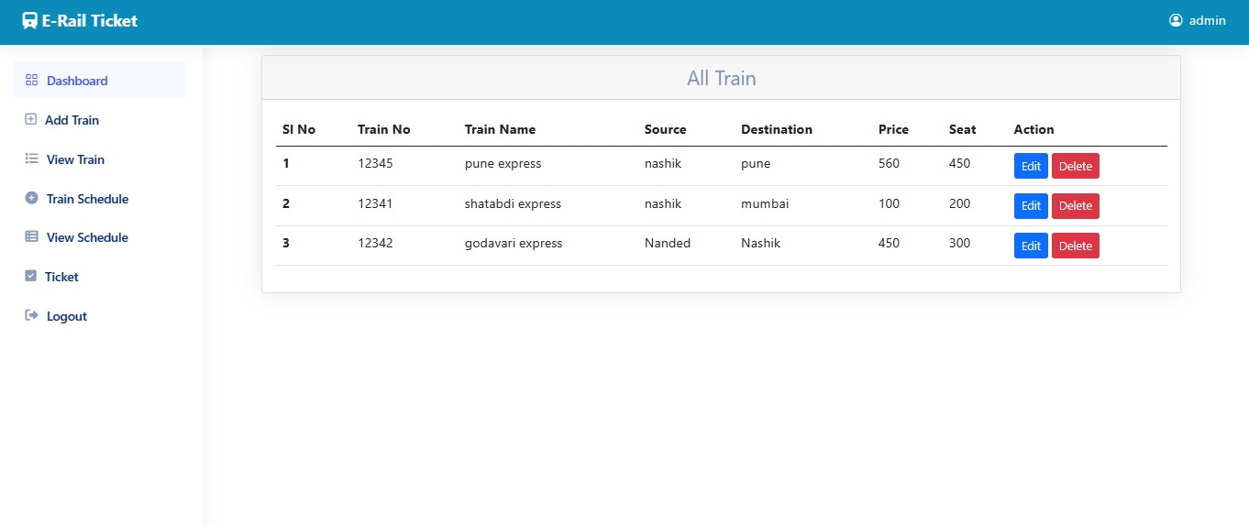
All Train Details

Slide 23
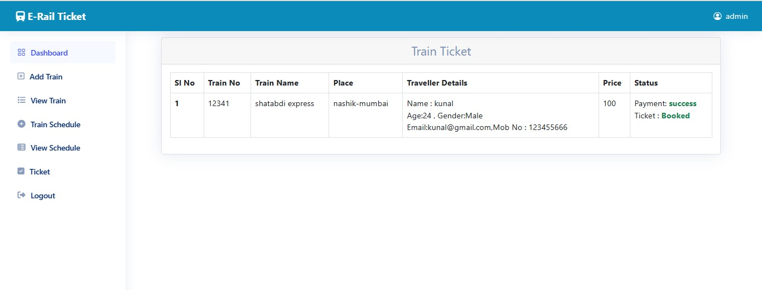
Ticket Details

Slide 24
THANK YOU

